Slide 1
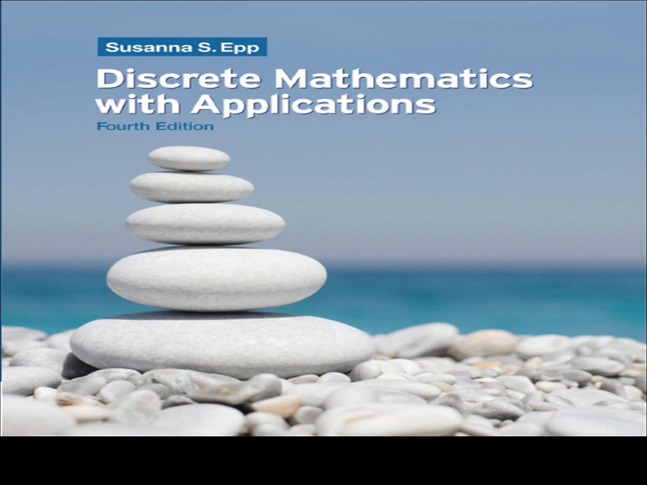
Week 2
Applications of Logics
Discrete Mathematics - BSCS

Slide 2
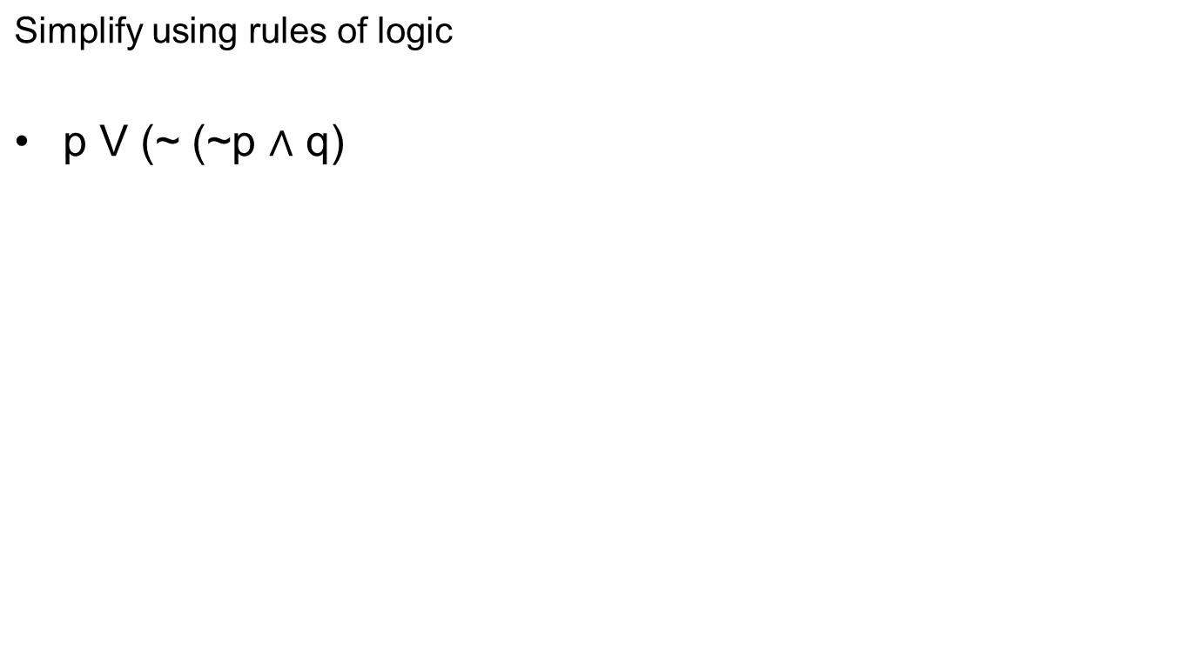
Propositional Logic

Slide 3
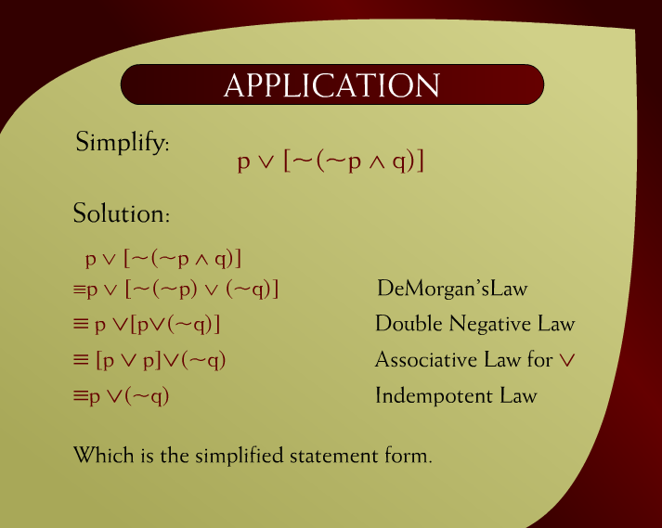
Application - 1
Discrete Mathematics - BSCS

Slide 4
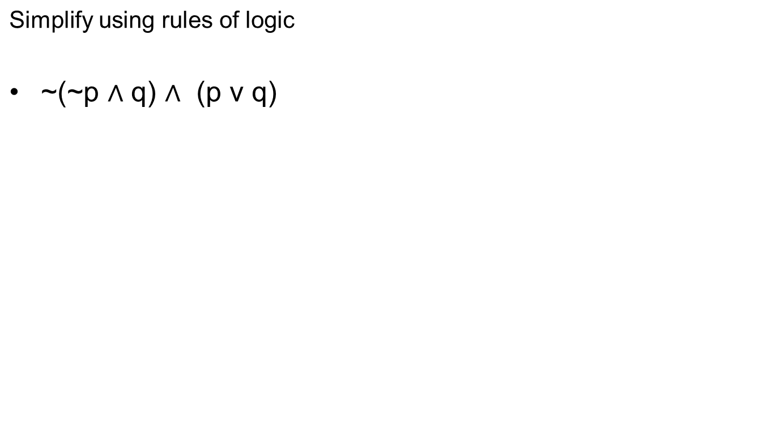
Propositional Logic

Slide 5
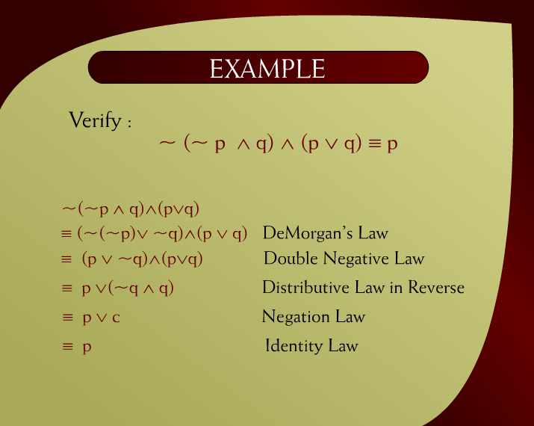
Example - 2
Discrete Mathematics - BSCS

Slide 6
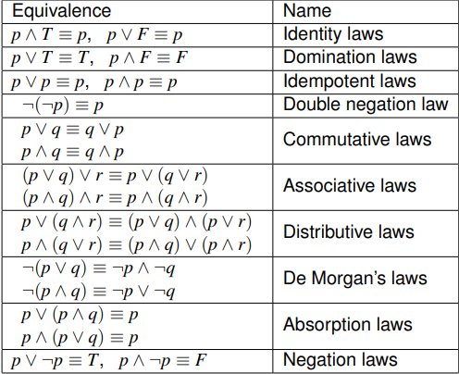
Discrete Mathematics - BSCS

Slide 7
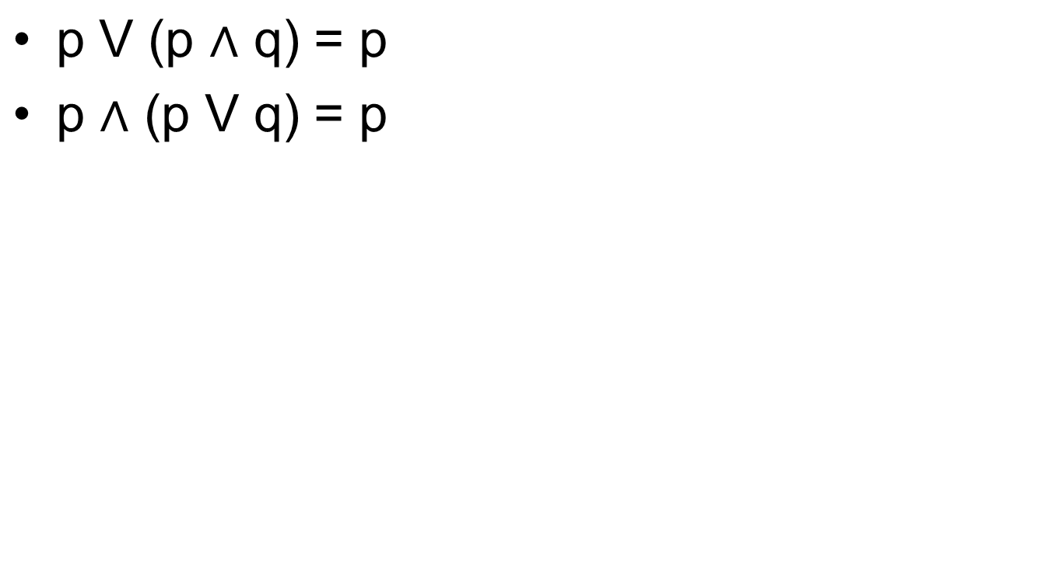
Absorbtion Rule

Slide 8
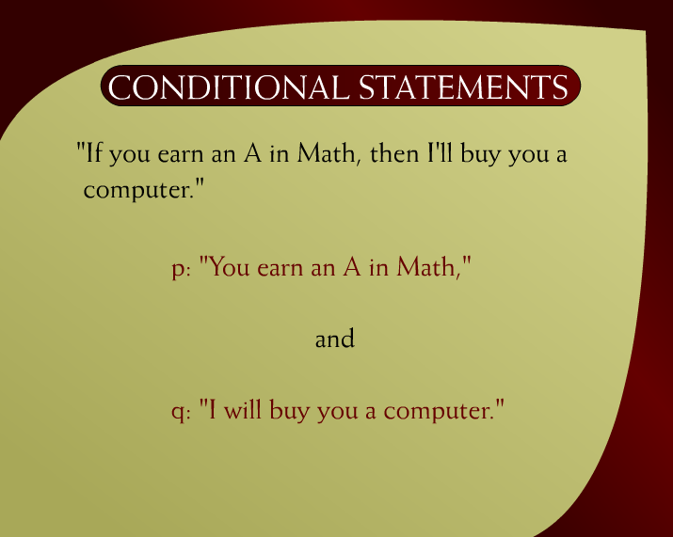
Conditional Statements - 6
Discrete Mathematics - BSCS

Slide 9
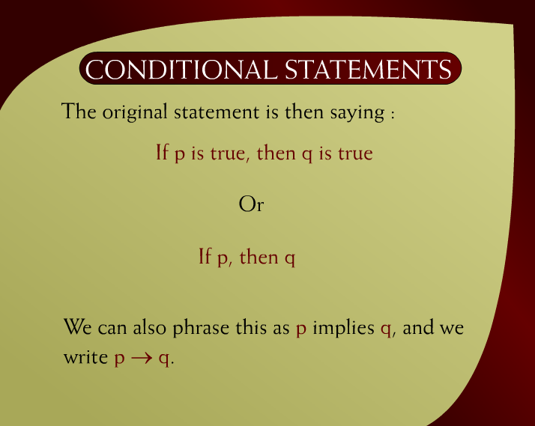
Conditional Statements – 6a
Discrete Mathematics - BSCS

Slide 10
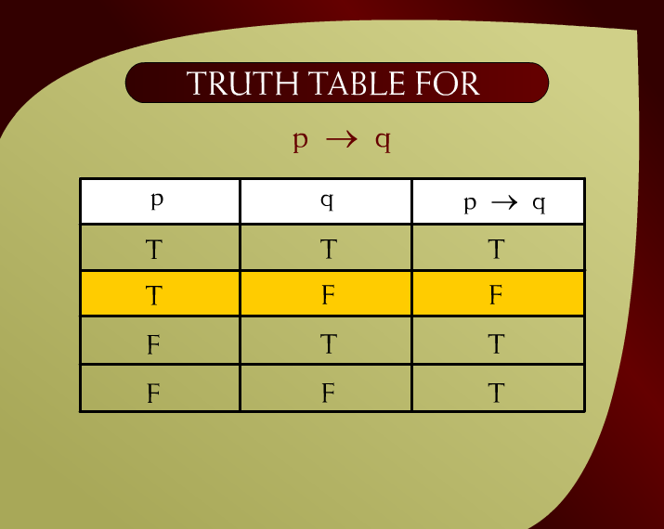
Truth Table for p → q - 8
Discrete Mathematics - BSCS

Slide 11
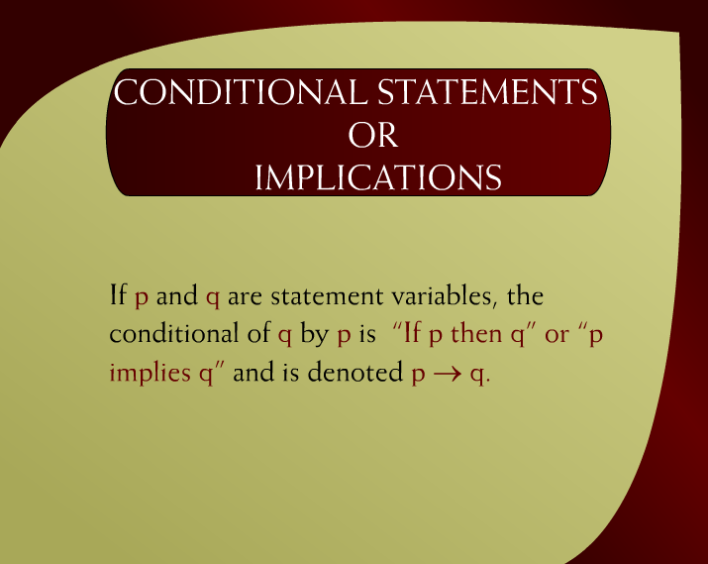
Conditional Statements or Implications - 7
Discrete Mathematics - BSCS

Slide 12

Conditional Statements OR Implications – 7a
Discrete Mathematics - BSCS

Slide 13
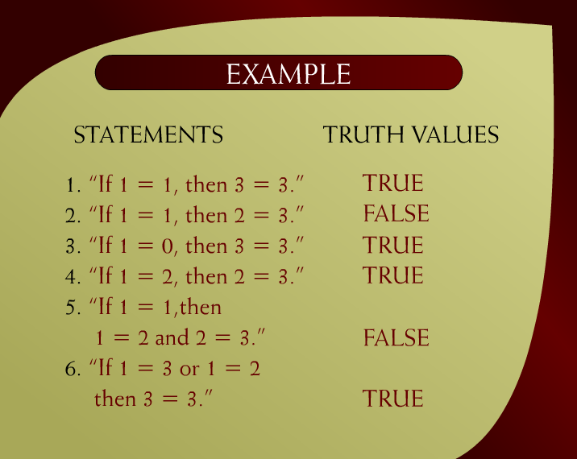
Example – 9
Discrete Mathematics - BSCS

Slide 14
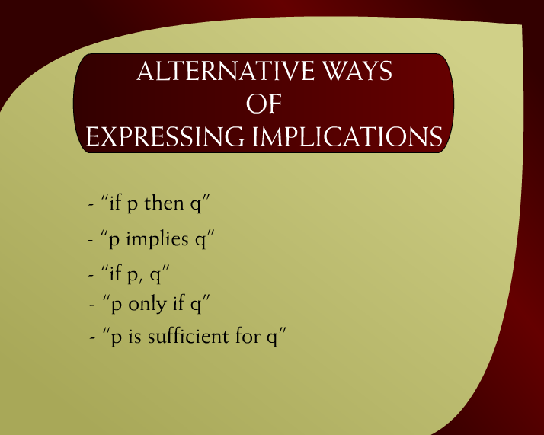
Alternative Ways of Expressing Implications – 10
Discrete Mathematics - BSCS

Slide 15

Alternative Ways of Expressing Implications – 10a
Discrete Mathematics - BSCS

Slide 16
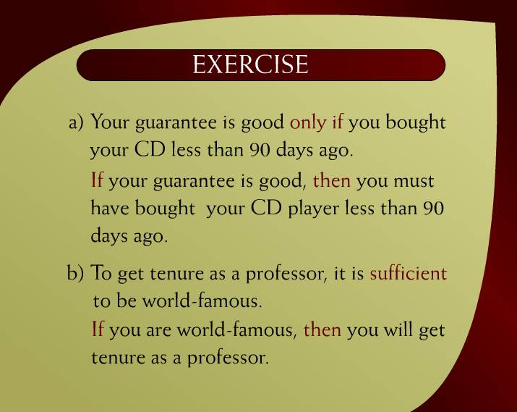
Exercise - 11
Discrete Mathematics - BSCS

Slide 17
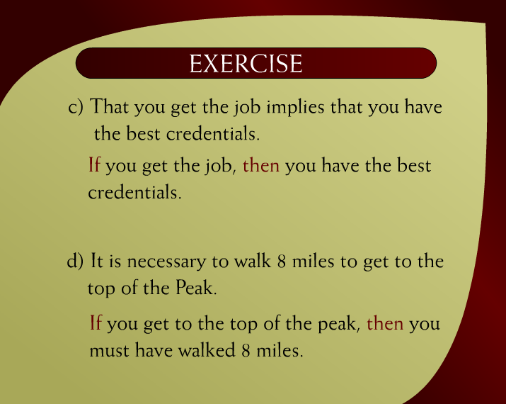
Exercise – 11a
Discrete Mathematics - BSCS

Slide 18
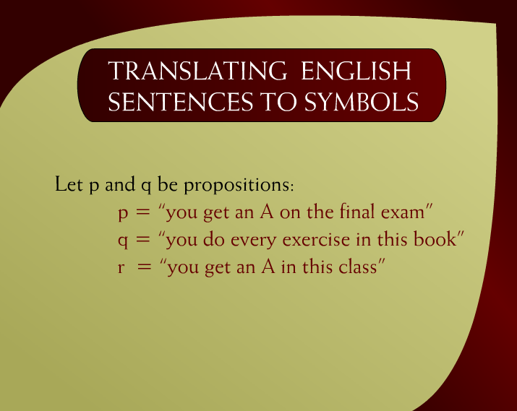
Translating English Sentences to Symbols - 12
Discrete Mathematics - BSCS

Slide 19
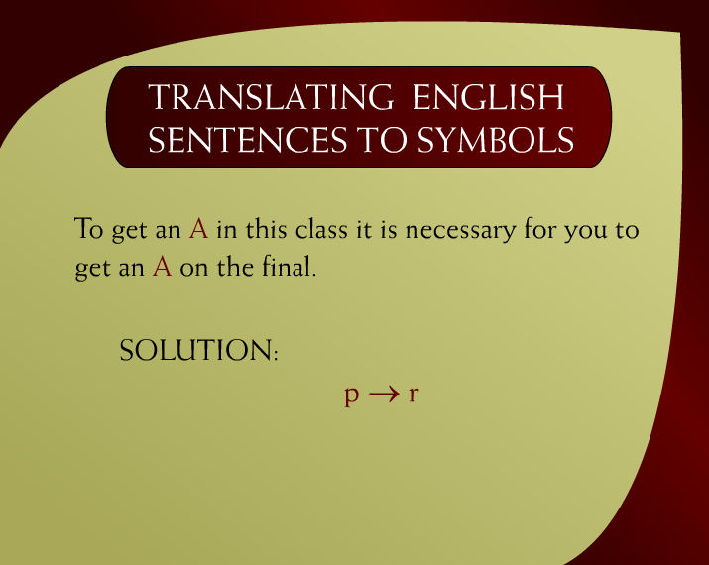
Translating English Sentences to Symbols – 12a
Discrete Mathematics - BSCS

Slide 20
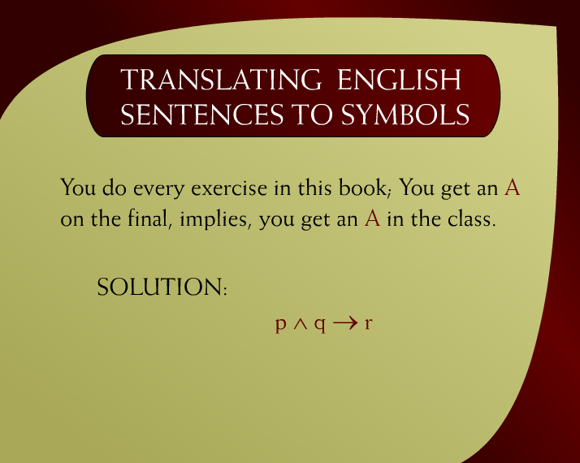
Translating English Sentences to Symbols – 12b
Discrete Mathematics - BSCS

Slide 21
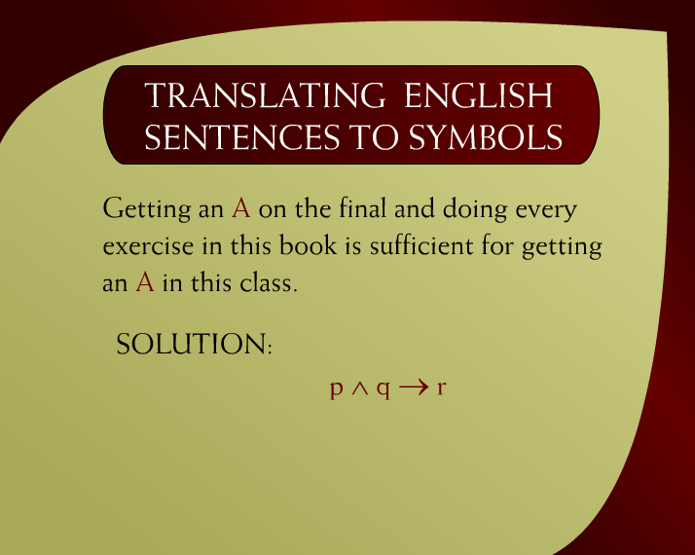
Translating English Sentences to Symbols – (3 – 12c)
Discrete Mathematics - BSCS

Slide 22
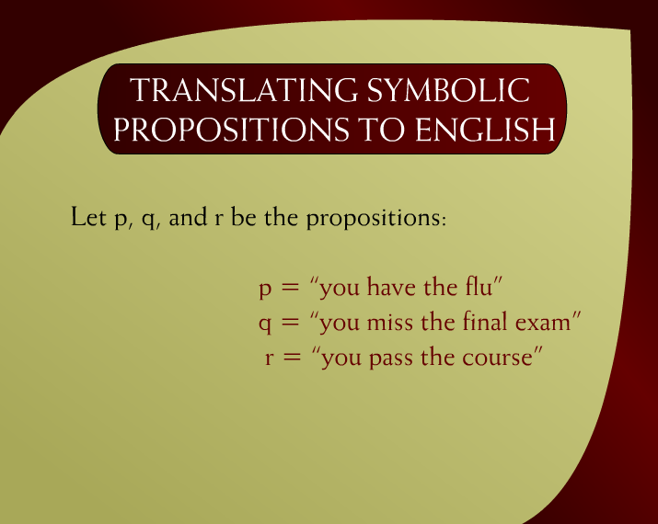
Translating Symbolic Propositions to English – 13
Discrete Mathematics - BSCS

Slide 23

Translating Symbolic Propositions to English – 13a
Discrete Mathematics - BSCS

Slide 24

Translating Symbolic Propositions to English – 13b
Discrete Mathematics - BSCS

Slide 25
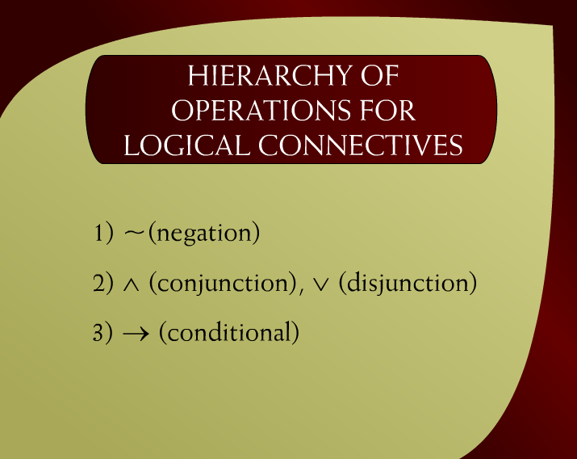
Hierarchy of Operations for Logical Connectives - 14
Discrete Mathematics - BSCS

Slide 26
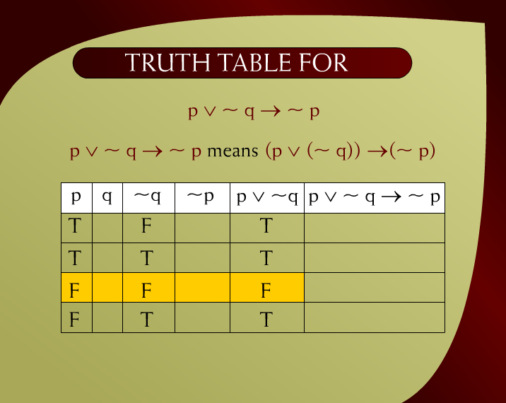
Truth Table for p v ~ q →~ p – 20a
Discrete Mathematics - BSCS

Slide 27
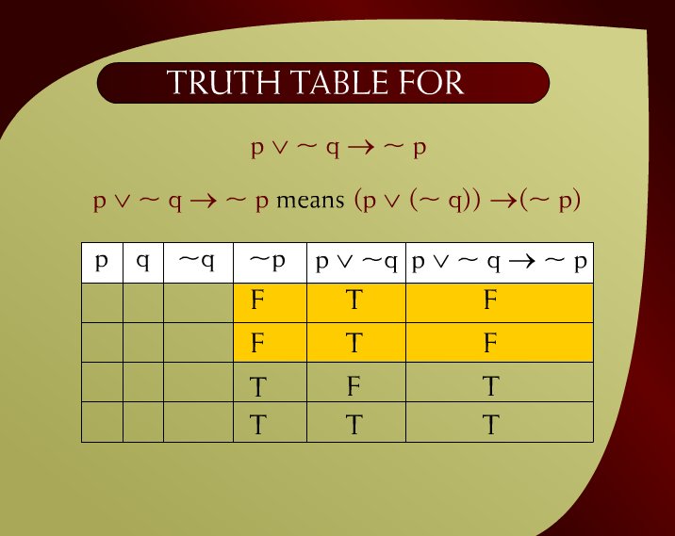
Truth Table for p v ~ q →~ p – 20b
Discrete Mathematics - BSCS

Slide 28
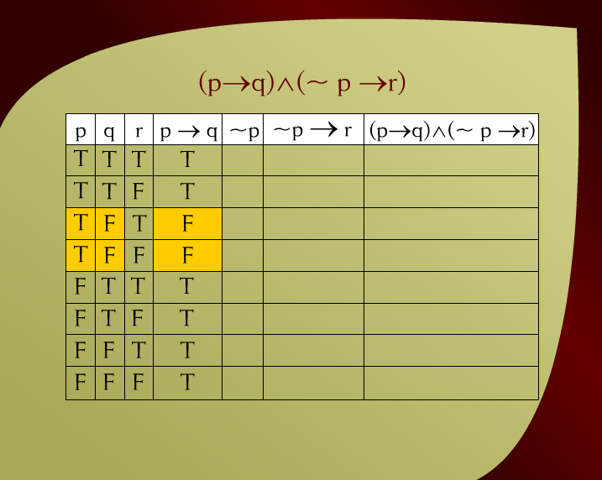
(p → q) (~p → r) - 21
Discrete Mathematics - BSCS

Slide 29
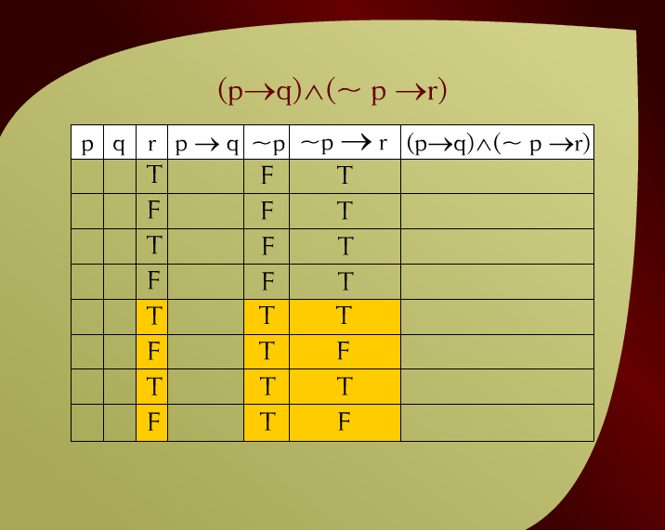
(p → q) (~p → r) – 21a
Discrete Mathematics - BSCS

Slide 30
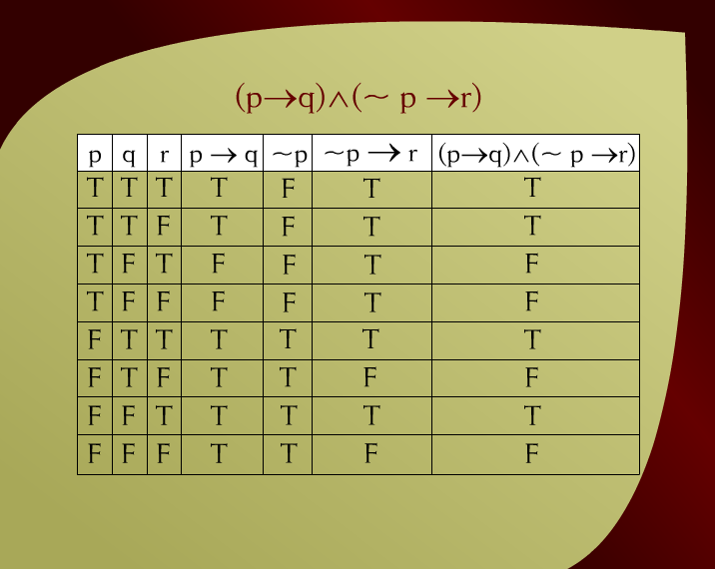
(p → q) (~p → r) – 21c
Discrete Mathematics - BSCS

Slide 31
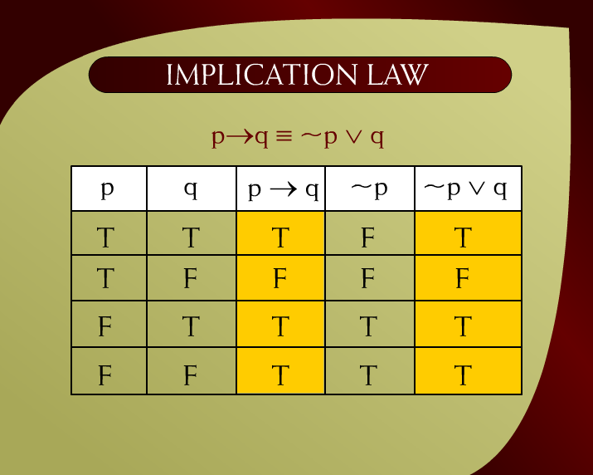
Implication Law – 23
Discrete Mathematics - BSCS

Slide 32
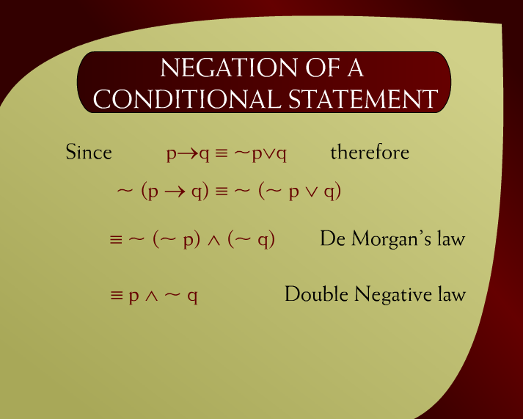
Negation of a Conditional Statement - 15
Discrete Mathematics - BSCS

Slide 33
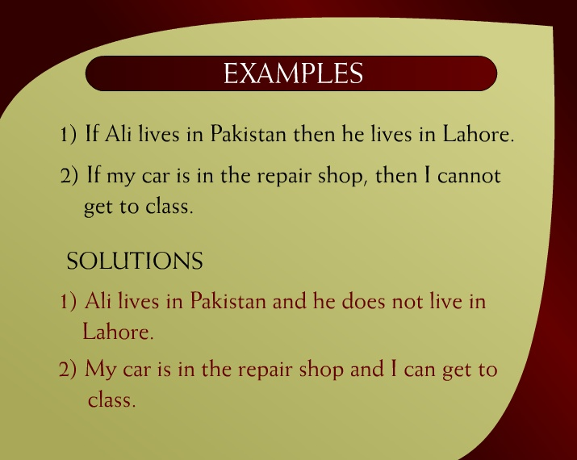
Examples – (3 - 16)
Discrete Mathematics - BSCS

Slide 34

Example – 16a
Discrete Mathematics - BSCS

Slide 35
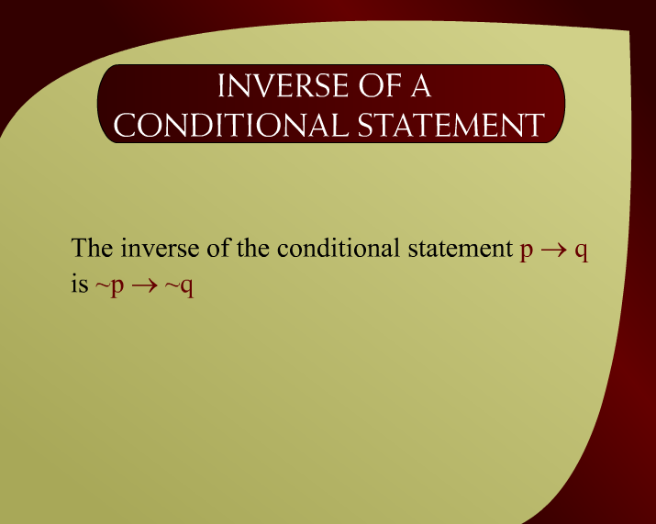
Inverse of a Conditional Statement - 24
Discrete Mathematics - BSCS

Slide 36
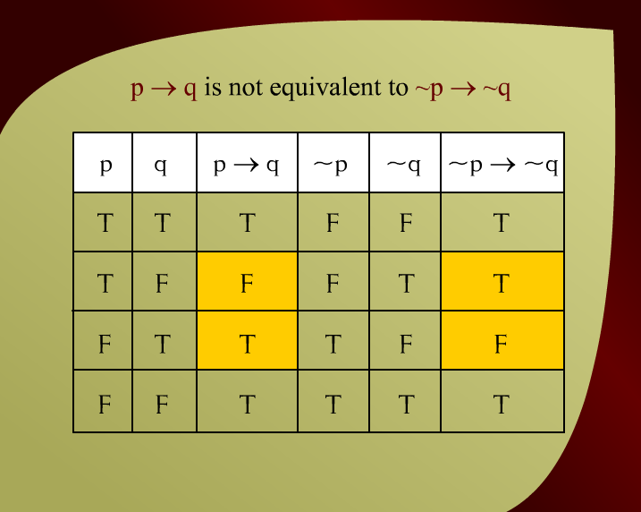
p → q is not equivalent to ~p → ~q – (3 – 25)
Discrete Mathematics - BSCS

Slide 37
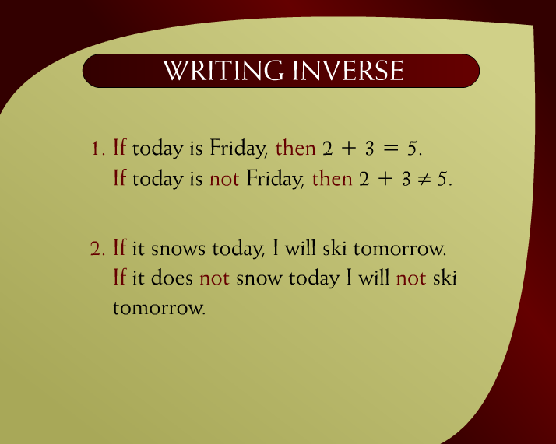
Writing Inverse – 17
Discrete Mathematics - BSCS

Slide 38
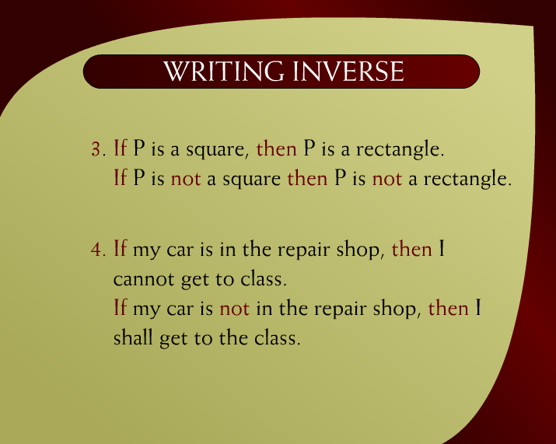
Writing Inverse – 17a
Discrete Mathematics - BSCS

Slide 39
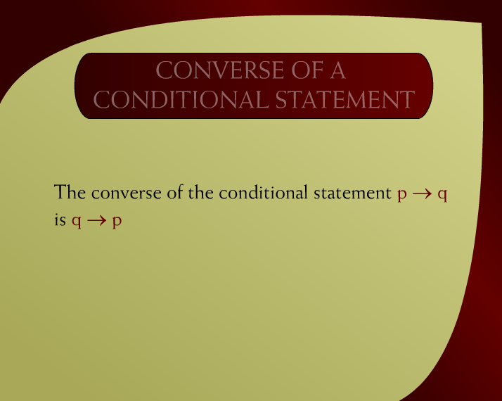
Converse of a Conditional Statement - 26
Discrete Mathematics - BSCS

Slide 40
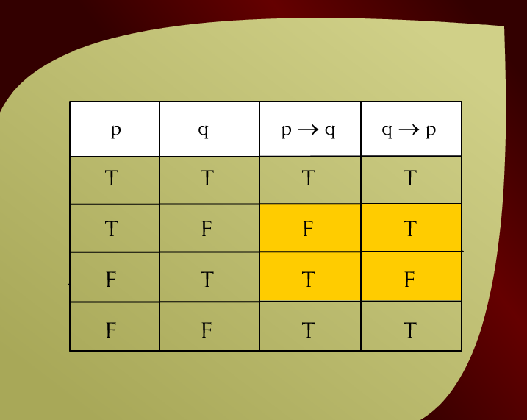
Converse of a conditional Statement – (3 – 27)
Discrete Mathematics - BSCS

Slide 41
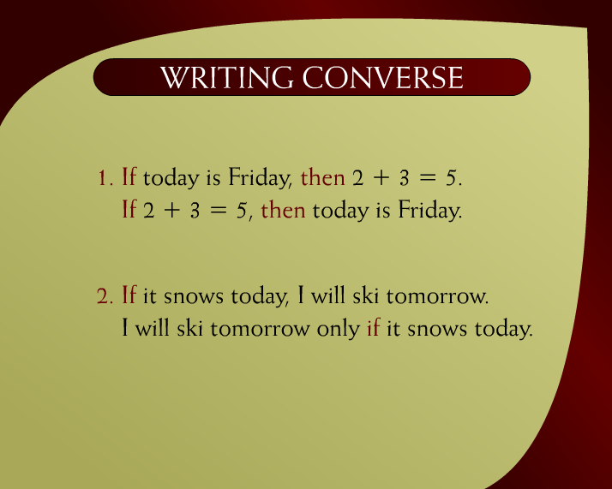
Writing Converse – 18
Discrete Mathematics - BSCS

Slide 42
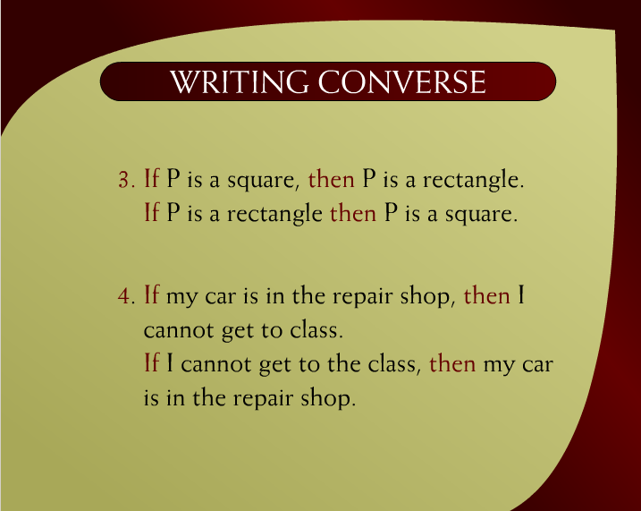
Writing Converse – 18a
Discrete Mathematics - BSCS

Slide 43
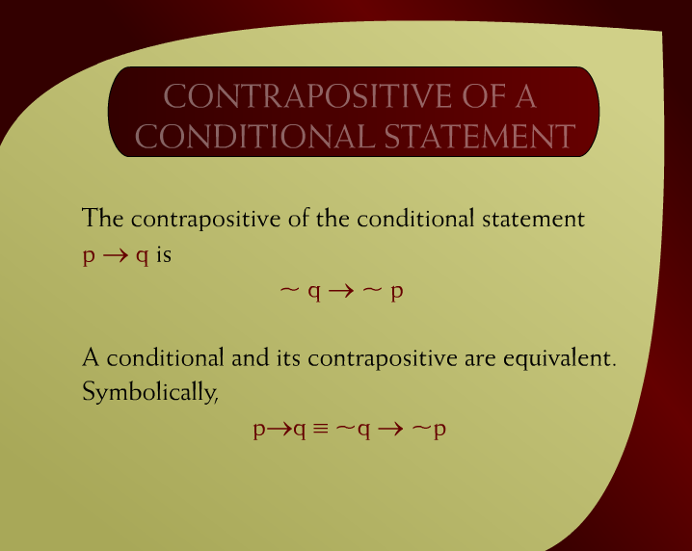
Contrapositive of a Conditional Statement– 28
Discrete Mathematics - BSCS

Slide 44
A statement is logically equivalent to its
contrapositive.
Discrete Mathematics - BSCS

Slide 45
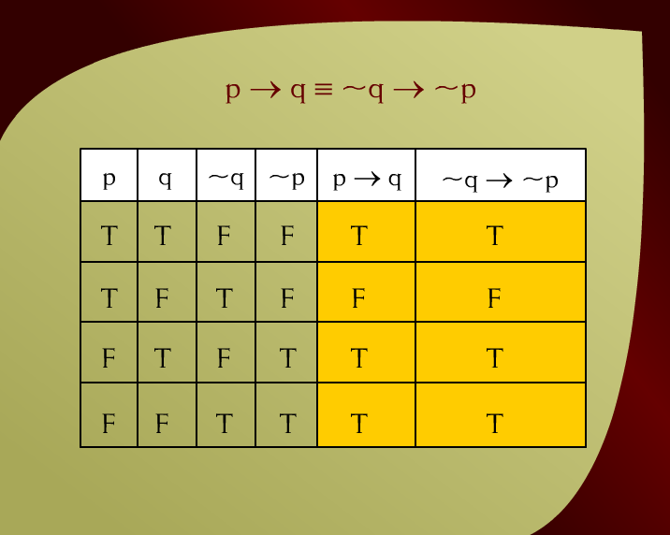
p → q ≡ ~q → ~p- 22
Discrete Mathematics - BSCS

Slide 46
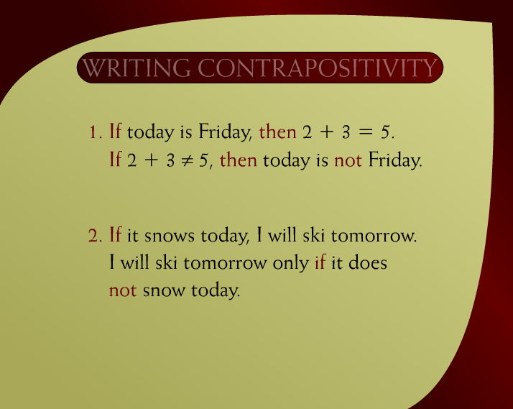
Writing Contrapositivity – 19
Discrete Mathematics - BSCS

Slide 47
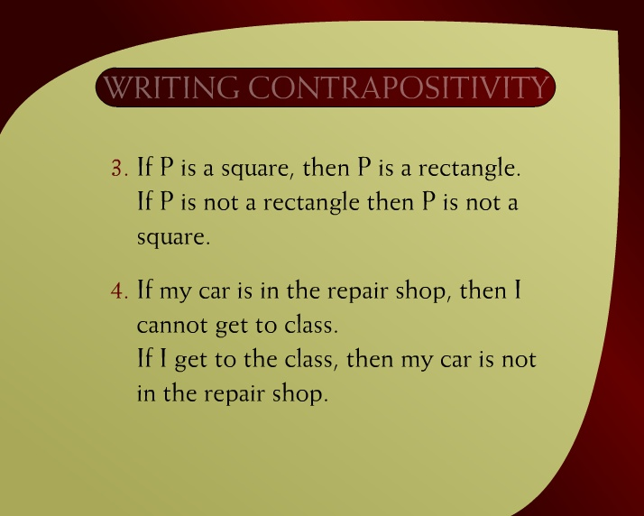
Writing Contrapositivity – 19a
Discrete Mathematics - BSCS

Slide 48
Implication Law
p→q ≡ ~p V q

Slide 49
Solve using laws of logic
p ∧ ~q → r

Slide 50
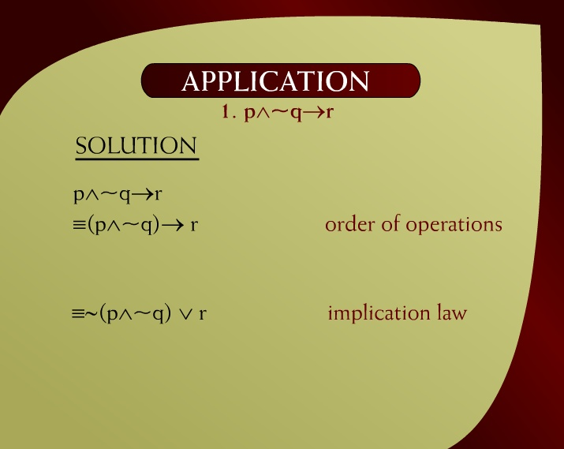
Application – 15
Discrete Mathematics - BSCS

Slide 51
Solve using laws of logic
~p V q → r V ~q

Slide 52
~p V q → r V ~q
(~p V q )→( r V ~q )
~ (~p V q ) V ( r V ~q )
(p ∧ ~ q) V( r V ~q )
Discrete Mathematics - BSCS

Slide 53
~(p→ q) → p

Slide 54
~(p→ q) → p
~(~p V q) → p
(p ∧ ~ q) → p
~ (p ∧ ~ q) V p
(~ p V q) V p
(q V ~p) V p
q V (~pV p)
qVt
t

